Slide 1
UNIT 3 Cyber Ethics
Notes:
Lesson Duration
60 minutes
Lesson Scope
The purpose of this lesson is to make students aware of the responsibilities of ethical behavior.
Ethics are important because they promote a sense of fairness in and throughout a community, either social or professional. They outline a set of rules and help us determine what we should do when faced with various situations.
Terminal Learning Objectives
Students will understand what ethics are and why they are important
Students will understand how to act ethically
Students will understand the responsibility that comes with knowing and using cybersecurity principles
Students will understand how to apply ethics to real-world situations
Enabling Learning Objectives
Students will understand the sources of ethics and how they apply to our understanding of right and wrong.
Students will understand the difference between understanding ethics and acting ethically.
Students will understand what it takes to act ethically and how to practice ethical behavior.

Slide 2
Learning Objectives
Students will understand:
What ethics are
Why ethics are important
How to act ethically
The responsibility that comes with knowing cybersecurity principles
How to apply ethics in the real world

Slide 3

Principles of Cyber Ethics
Do not:
Do not use a computer to harm other people.
Do not interfere with other people's computer work.
Do not snoop around in other people's computer files.
Do:
Do not use a computer to steal.
Do not use a computer to bear false witness.
Do not copy or use proprietary software for which you have not paid.
Do not use other people's computer resources without authorization or proper compensation.
Do not appropriate other people's intellectual output.
Do think about the social consequences of the program you are writing or the system you are designing.
Do always use a computer in ways that ensure consideration and respect for your fellow humans.
Notes:
The principles of cyber ethics listed above have been adapted and adopted by the CyberPatriot program as the ethical guidelines for the program. These principles recognize that as part of the CyberPatriot program, you may be given access to tools and skills that other are not given. This responsibility carries with it increased ethical weight and these principles can help you better navigate the choices you may be asked to make.
It should also be noted that these principles or this code of ethics is really just an application of our general ethics to the cyber realm.
Teachers should go through these item by item.

Slide 4

Introduction
Ethics is about right and wrong
What is right?
What is wrong?
How do we know?
Notes:
The definition of actions that are “right” or “wrong” is a key consideration of ethics. But almost as important is how we know the difference between right and wrong.
Try to get the students to answer these questions as a group.
Can they come up with a good definition of right and wrong?
Can they articulate why things are right and wrong?
The goal is to get students to understand that while we all intuitively have an understanding of right and wrong, but when we try to write that down, it’s very difficult.

Slide 5

Why Ethics?
Promotes a sense of fairness
Creates a set of rules or acceptable behaviors
Ethical practices help us identify and what unacceptable behavior “looks” and “feels” like
Notes:
We are faced everyday with decisions that could change the outcome of our lives or the lives of others. Should we lie to our parents or our friends? Should we answer just one text message while we’re driving? Should we cross the street against a red light? Should we listen to our teachers? Should we say that hurtful thing we’re thinking? Should we help that stranger in need?
Each of these questions has a right answer. Having a set of written ethics can help us more effectively make good decisions. The goal is to identify what we should do before we’re placed in the situation so that we can be prepared to make the right choice.
We all need ethics because they help us determine what is right and wrong.
They help us determine how to act in a given situation.
They can help us identify unethical behavior.

Slide 6

What is Ethics?
Standards for right and wrong
What we should do in different situations
Can be both written and unwritten
Written: company mission statements, school policies on academic dishonesty
Unwritten: don’t “cut” in a line, opening doors or holding elevators for people
Notes:
What are some examples of unwritten rules? Motorcyclists, for instance, will often acknowledge the presence of a passing motorcyclists with hand gestures. Many of these gestures transmit important information about upcoming road conditions, dangers, or are simply an attempt to say “hello.” Discuss with your class some other situations that demonstrate some type of “universal knowledge.”
Ask the students to identify any written or unwritten ethical rules that they may have at school or among their friends.
Students may be reluctant to share at first, or not know what to share, so sharing any rules that you may have as an example can get them started.

Slide 7

Sources of Ethics
Laws
Feelings
Societal Norms
Religion
Philosophy
Family
Notes:
There are many topics that inform our personal ethical judgments. While these topics are central in determining ethical actions, they are not the sole determinant of ethical behavior. We can all think of things that may be legal, but are definitely unethical. While there isn’t a law against being mean to a sibling or friend, it certainly isn’t the right thing to do.
Ask students if they have any other sources of ethics.
Most times our friends also help inform our ethics.
The strong feelings a friend has or the things that may have happened to a friend can often have a very strong impact on our own ethics.

Slide 8
Ethical Behavior
Do people make good decisions?
Do people always make good decisions?
Do YOU make good decisions?
Do YOU always make good decisions?
Does a bad decision mean you’re unethical?
Notes:
It’s important to understand that we are often faced with situations in which we behave in ways that we may regret. Making a bad decision doesn’t make you unethical. The important thing is to identify when we’ve made mistakes and do our best to correct them.
This slide is intended as a discussion slide to introduce the idea of understanding right from wrong vs. behaving accordingly.
If students feel that they always make good decisions, they may be falling victim to something called overconfidence bias.
Overconfidence bias occurs when we believe that we always act ethically.
This overconfidence can lead us to make decisions without seriously reflecting on the ethics of the situation.

Slide 9

Understanding vs. Behavior
Knowing right from wrong doesn’t automatically mean we DO the right thing
Notes:
Doing the right thing is often harder than knowing what the right thing is. The goal of a code of ethics is to help inform our actions. But ultimately it takes more than knowledge to do the right thing.
Doing the right thing in ALL situations means that we have PRACTICE doing the right thing in EVERY situation.
Ethical behavior doesn’t just happen because we know what’s ethical.
In the activities for this lesson, students will apply ethics to real-world scenarios.
This will bring a better understanding of how difficult it can be in the real world to make the right decision.

Slide 10
Ethical Behavior Requires
Courage
See something, say something
Be willing to go against your friends/peers
Stand up to bullies
Humility
Even you can make a wrong decision
Are you a better than the average driver?
Are you more ethical than the average person?
Notes:
Behaving ethically requires us to demonstrate courage. It requires that we speak up when we see unethical behavior. It requires that we stand up to our bullies as well as our friends. Doing these things requires courage and that is not something that can be taught, it can only be practiced. Behaving ethically also requires humility. That is, we must be able to look at ourselves as imperfect people and in each decision strive to make the right choice, the ethical choice.
Just because we want to act ethically doesn’t mean we will. In many cases, acting ethically will require us to go against what a friend or family member wants us to do.
It requires courage to stand up to those people for what we believe is right.
Overconfidence bias occurs when we believe that we always act ethically.
This overconfidence can lead us to make decisions without seriously reflecting on the ethics of the situation.
In 1988, Ola Svenson conducted a survey of drivers in the U.S. and Sweden.
In the survey, Svenson asked if each driver thought that they were safer than the average driver.
88% of drivers answered that they believed they were safer than the average driver.
This is not possible.
Generally, we all believe that we are better in comparison to others.
This type of overconfidence can lead us to feel satisfied with ourselves and not seek to be the best possible version of ourselves.

Slide 11
Questions
Does the Internet make it easier or harder to act ethically?
Is it easier or harder to do the right thing when others are watching?
Is it easier or harder to do the right thing when it means that you have to choose between friends?
Notes:
There are situations and conditions that can make acting ethically more or less difficult. If we can identify that the situations that test our ethics, we can be more thoughtful of our actions in those situations.
When situations involve our friends or peers, we can feel forced to choose between loyalty to our friends or ethical behavior. We should understand that such situations are difficult and make the choice to act ethically before we find ourselves in those situations.
This slide is meant for discussion.
The title of the slide appears and a question appears after each subsequent click.
People generally behave more ethically when they are being observed than not.
The feeling of anonymity can lead to unethical behavior.
Interacting over the Internet generally allows people to FEEL more anonymous than if those same interactions were in person.
This is a good point to bring up during conversation of the first question and get students to discuss whether they feel more anonymous online.

Slide 12
CASE STUDY 1 Terry Childs As told by former San Francisco Mayor Gavin Newsom to Slate Magazine
Notes:
INSTRUCTOR READ: Terry Childs was a 43-year-old network engineer for the city of San Francisco. He worked on our fiber-optic network, called FiberWAN, which handled crucial government data, such as email, legal documents, and payroll. By most accounts, he was a diligent and talented employee, and he seemed dedicated to making sure our systems ran safely. Childs spent hours trying to perfect our FiberWAN system, upgrading equipment and installing firewalls. In the summer of 2008, Childs was reassigned, and when he was instructed to hand over the password he had created for FiberWAN, he refused.
No one could get into the FiberWAN without that password—emails were inaccessible, payroll couldn’t go out, and documents were under virtual lock and key. The city was in crisis. We had to have that code! We spent at least $1 million, including hiring a team at Cisco Systems, to crack the code, but they couldn’t do it.
We had no choice but to try to compel him to give up the password, so the police arrested Childs on a charge of felony computer tampering and put him in jail. But he still wouldn’t give up the code. I was as honest as I could be, asking him to give me the code as a favor, if nothing else. And he responded. Childs said he didn’t trust his bosses or colleagues, but at that moment, he trusted me. He wrote down the code—all 28 numbers and letters of it—and handed it over.
Excerpted from: http://www.slate.com/articles/technology/future_tense/2013/02/fiberwan_terry_childs_gavin_newsom_on_why_governments_should_outsource_technology.html

Slide 13
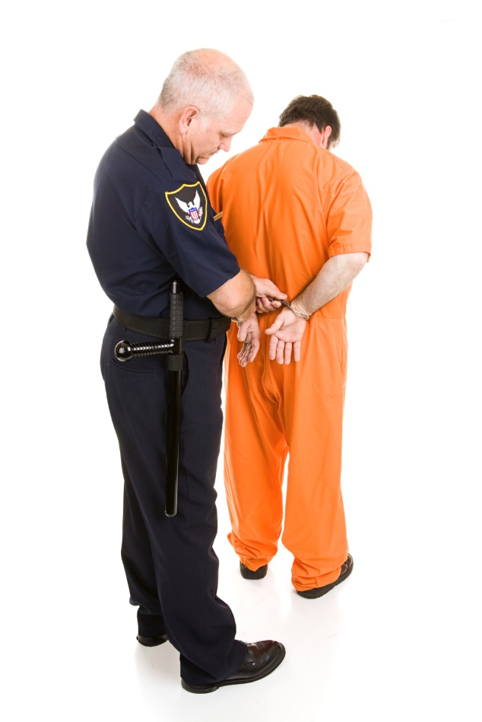
Terry Childs
Should Terry Childs have been arrested?
Which principle(s) of cyber ethics did Terry Childs violate, if any?
Notes:
What do you think?
Terry Childs violated several U.S. laws and was found guilty of those violations by a jury.
That being said, there has been strong debate about what should have happened.
This is meant only as a point of discussion, not as the prompt for a legal debate.
Terry Childs could arguably be accused of violating a number of the cyber ethics principles, but the one that most closely matches is:
Do not interfere with other people’s computer work

Slide 14
CASE STUDY 2 Desmond Hague Former CEO of Centerplate
Notes:
INSTRUCTOR READ: The CEO of Centerplate, a catering company that serves food at sports stadiums around the country, was caught on camera kicking a dog in a Vancouver elevator.
After issuing a public apology, Hague agreed to attend anger management counseling, serve 1,000 hours of community service and donate $100,000 of his own money to an animal charity.
Less than a week later, he was forced to resign.
From all other metrics, Mr. Hague was a good CEO; his company grew and profited while he was in charge.
Excerpted from http://fortune.com/2014/09/02/centerplate-ceo-des-hague-dog-abuse-fired/

Slide 15
Desmond Hague
Should Mr. Hague have been forced to resign?
Notes:
Ethics in the real world can sometimes look very different. Mr. Hague might have assumed that no one was watching since he was alone in an elevator when he kicked the dog. Mr. Hague was in the elevator of his own home and was not working at the time. What does this say about how ethics works in real life?
As was discussed earlier, while laws are one of the things that help inform ethics, they are not by themselves what ethics is about.
In this case, the actions of Mr. Hague were questionable, but probably not to the point of being illegal.
However, it’s very clear that what he did was unethical.
This example embodies the difference between moral agents and moral patients or subjects of moral worth.
A moral agent is someone who has the power to intentionally cause harm.
A subject of moral worth is someone or something that is vulnerable – children and pets, for example.
We expect moral agents to do everything in their power to protect subjects of moral worth, and we punish moral agents more harshly when they cause harm to subjects of moral worth.

Slide 16
CASE STUDY THREE Wesley Autrey Subway Superman
Notes:
INSTRUCTOR READ: Mr. Autrey was waiting for the subway in Manhattan with his two daughters. Nearby a man collapsed with a seizure. Mr. Autrey and two women rushed to help. The man managed to get up but then stumbled and fell onto the tracks.
In an instant, Mr. Autrey jumped onto the tracks
Mr. Autry pressed himself and the man into the space between the tracks. It gave them just enough room to avoid being hit by the train. Five train cars rolled past before the train finally came to a stop. Both men were relatively unharmed.
Excerpted from: http://www.nytimes.com/2007/01/03/nyregion/03life.html

Slide 17
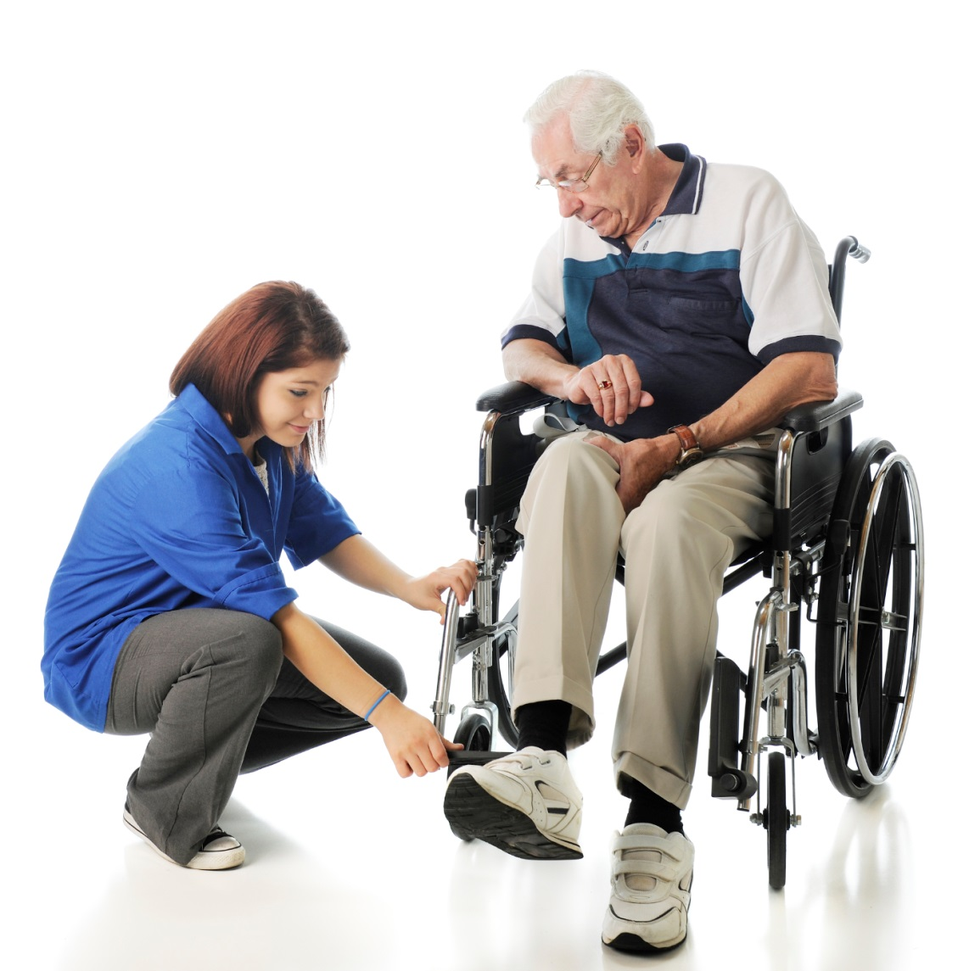
Wesley Autrey
Could we have done the same thing?
Notes:
This is a question that we all need to ask ourselves. We would like to think that in life or death situations we would make the right choice, but if we don’t practice in our everyday situations, how can we expect to be prepared?
Students can start acting ethically today.
They don’t have to wait for an extraordinary event to be an everyday hero.

Slide 18
AFA CYBER ETHICS UNIT Ethics Activity
Notes:
Purpose
This exercise will help students understand how ethical situations might present themselves in the real world.
Description
Students are presented with a variety of situations and courses of action. Students are then asked to choose the most ethical course of action in each situation. In some situations, there are answers that are clearly more ethical than others, but this is meant to be an activity with ambiguity.
This activity is designed to have two parts. In the first part, students are split into groups of 3 or 4 and asked to discuss the scenarios and choose a course of action as a group. It is important to keep the groups small so that students can discuss the issues among themselves and everyone gets a chance to talk. In larger groups students may feel overwhelmed and less likely to share their views, especially if they go against the group.
In the second part of the activity, the class should have a brief discussion of each of the scenarios. This can allow for a larger discussion of some of the key issues. This portion can be skipped if time is short.
Estimated Completion Time
20 - 30 Minutes. Estimated time is for completion of 3-4 scenarios.

Slide 19
SCENARIO 1 Hack, No Hack?
Notes:
This activity is designed to place students in an ethical dilemma that would be similar to something they would encounter in the real world.
As students continue to learn cybersecurity methodologies, they will become familiar with the techniques that “hackers” use to break into sites.
Knowing this, friends could ask them to use their skill sets to help get them out of a bad situation.
It is important that students understand that just because you may want to help a friend out, it doesn’t mean that you should engage in unethical behavior.

Slide 20

Scenario 1: Hack, No Hack?
Emily posted a picture of your friend Jayden on Instagram. The picture makes it look as if Jayden is consuming alcohol, but you know that he wasn’t. Your friend Jayden is very upset and Emily refuses to take the picture down. Jayden asks for your help in getting into Emily’s Instagram account to remove the picture.
What should you do?

Slide 21
Scenario 1: Hack, No Hack?
You don't want Jayden to get into trouble. So you tell him that you're only going to help this once. Then you use a tool that you found on the Internet to help Jayden get into Emily's Instagram account and remove the picture.
You let Jayden know that Instagram allows people to report images that violate their rules. You help Jayden contact Instagram to have them remove the picture and you let him know that it may take a few days to get an answer.
You don't want to be a bad friend, so you help Jayden remove the picture. Then, you change the Emily’s password so she can't repost the picture. Later, you borrow Emily’s phone and delete the picture from there too so that this situation will be over.
You explain to Jayden that it's his fault for being in the picture in the first place and Emily shouldn’t have to take down the picture. You also explain how things can stay on the Internet forever and that you don't want to be friends with people who don’t make good decisions.
Notes:
Incorrect: Even if it’s just one time and you promise never to do it again, breaking into someone else’s account is unethical.
Correct: As security professionals we aim not only to secure cyber systems, but also to guide others through difficult processes to remediate conflicts.
Incorrect: This response only further compounds an ethical breach by further locking someone out of their account, and then intentionally deleting information from another person. This is possibly a worse solution than response A.
Incorrect: Although this may seem like a valid response (albeit, harsh), ethical practices also encompasses how we treat others. Also, there exists the possibly that Jayden may go to someone else to try to remedy his issue, which may allow the unethical practice to occur. Not only should we not engage in unethical practices, but we should try to mitigate them as well.

Slide 22
Scenario 1: Hack, No Hack?
Discussion
Notes:
While Jayden may feel that the picture casts him in a bad light, Emily may not feel the same way.
She may feel that Jayden is overreacting and see no reason to remove the picture.
In situations like this, it is easy to feel forced to “choose a side.”
Ultimately, we don’t have to be the judge, jury, and executioner for all of the disputes between our friends.
In this case, we can help Jayden take the appropriate steps without having to “choose a side.”

Slide 23
SCENARIO 2 How do we deal with a bully?
Notes:
Instructor Notes:
This scenario gives students an opportunity to work through the concept that two wrongs don’t make a right. Someone else breaking the rules does not give us the right to act unethically.

Slide 24

Scenario 2: Bullies
You and your friends are playing an online game and a classmate, Alex, is logging on and breaking the rules. Alex’s obnoxious behavior is making it very difficult for you and your friends to enjoy the game. You have reported him to the game publisher, but he keeps creating new accounts and harassing you.
You recently found a tool on the Internet that allows you to remove a person’s computer from the game temporarily. The website where you found the tool says that it doesn’t cause any long term damage.
What should you do?

Slide 25
Scenario 2: Bullies
You should use the tool you found just this once so you can enjoy your game in peace.
You and your friends have paid for this game like everyone else and you deserve to play it without being harassed. You should use the tool anytime Alex comes on and starts harassing you.
You look up the standards of conduct and complaint procedures for the game. You tell your parents, or another adult, about Alex’s harassment and ask them to help you report the behavior appropriately.
All the things that Alex is doing to you, you should do back to him. He should treat people the way he wants to be treated.
Notes:
Incorrect: Do not allow yourself to engage in unethical behavior just because it quickly solves a problem.
Incorrect: The only difference with this response and the previous one is the attempt to rationalize the behavior.
Correct: When in doubt about how to handle a situation, try to find some documented resources, or ask an adult you trust to help you find a solution.
Incorrect: Remember, we have a duty to act ethically as well. Acting like a bully to stop a bully is not a solution.

Slide 26
Scenario 2: Bullies
Discussion
Notes:
The information below can help frame your discussions with students.
It may seem that using a tool that doesn’t do any real harm to a computer is an effective way to deal with a bully or person harassing you. However, these tools can have side effects even though others claim that they don’t. There may even be laws that make using these tools illegal. A bad decision is a bad decision whether you make that decision ten times or just once and you will have to deal with the consequences. Even though you deserve to play games and interact with your friends without being harassed, there are ways to deal with harassment that don’t potentially put you in a worse situation. Talk to an adult you trust and don’t become a bully or harasser to others.

Slide 27
SCENARIO 3 Am I still responsible?
Notes:
This scenario is designed to show that there are different ethical standards for those who have different roles and responsibilities. This is important when discussing cybersecurity because often those in the field have access to privileged information and with that access comes greater ethical responsibility.

Slide 28
Scenario 3: Am I still responsible?
It is Sophia’s first day as an intern in a computer security firm, and she and her supervisor, Christopher, walk by another intern’s computer workstation. The workstation has not been locked down and they notice that the browser is currently opened to the user’s banking website. Christopher, is a well-respected person in the firm, but a bit of a practical joker, and decides play a joke on this person’s unsecured computer. He logs out of the banking website to protect the user and then proceeds to change the computer desktop background to kitten images.

Slide 29

Scenario 3: Am I still responsible?
Sophia feels uncomfortable about what Christopher is doing, and asks if his actions are a good idea; he states “Nah, it’s not a big deal, besides it’ll teach him a lesson.” She laughs and says, “Okay, then we should make the background My Little Ponies.” Christopher locks down the station, and he and Sophia step aside and wait to see what happens.

Slide 30
Scenario 3: Am I still responsible?
Have Sophia and Chris acted ethically? Why or why not?
The intern returns, unlocks his station, and becomes visibly upset. He logs back into his banking site and furiously begins looking at his transaction history. Sophia notices that he looks upset, approaches the intern, and apologizes for what happened and assures him that nothing malicious happened. The intern is initially irritated but then tells her it is ok. He was just initially scared and was worried about someone stealing his banking information. Does the intern’s acceptance of the joke exculpate Christopher and Sophia’s actions ethically? Why or why not?
Notes:
We expect authority figures to act and behave in a manner that is both professional and ethical. If at any time you feel that a practice you may engage in is unethical, you should voice your concern over it. Doing the right thing means not only “knowing” and “doing,” but stopping unethical behaviors.
As harmless as a joke may seem, we have to remember that people do not always share the same opinions about things. What may seem like a harmless joke or comment, may in fact be very inappropriate. Also remember: people often “downplay” the harm a joke, or offensive comment, may impact them.

Slide 31
Scenario 3: Am I still responsible?
Discussion
Notes:
There are certain people that we hold to a higher standard than everyone else. We expect superiors to do the "right thing" in every situation. Even if we might consider it no big deal, we wouldn't expect our boss to behave in the same way. Generally we expect more of people in positions of authority and responsibility.

Slide 32
SCENARIO 4 Good Intentions
Notes:
This scenario takes the idea presented in the previous scenario and adds the idea of intention. It allows students to discuss the concept of the ends justifying the means.

Slide 33
Scenario 4: Good Intentions
Ashley recently took a computer security class where she learned about Wi-Fi. She learned that some Wi-Fi passwords can be easily broken. Ashley, who is excited about what she has learned in class, shares what she learned with her aunt. Her aunt states that the store where she works has Wi-Fi with one of these easily broken passwords, but doesn’t disclose to Ashley what that password is.
Notes:
We ask students to judge whether a behavior can be ethical if the intent is good.

Slide 34

Scenario 4: Good Intentions
Ashley tells her aunt that is a problem but her aunt tells her that they have very good IT people who will keep them protected. Ashley really wants to help the store where her aunt works, so she breaks the password to prove to her aunt that the system really is broken.
Notes:
We ask students to judge whether a behavior can be ethical if the intent is good.

Slide 35
Scenario 4: Good Intentions
Has Ashley acted ethically? Why or why not?
Assume Ashley did not use the password to access the Wi-Fi or any other systems connected to the Wi-Fi. She only showed her aunt the password to help make the store more secure. Does this change your answer?
Notes:
No, good intent does not excuse unethical behavior.
It is difficult to delineate when an unethical behavior becomes something that could potentially be more serious. At what point has a person gone too far after initially breaching a system? This lack of clarity, and permission, should be sufficient warning to not engage in this unethical practice.

Slide 36
Scenario 4: Good Intentions
Discussion
Notes:
The reasons that we take action matter. However, good intentions do not necessarily make actions ethical. Ashley told her aunt about the problem, but her aunt did not give Ashley authorization to further explore the Wi-Fi or to prove the problem. In the second part of the scenario, we make a distinction between passively gathering data and actively gathering data. In some cases this could be the difference between an action being legal or illegal. However, legality and ethics are not always the same the thing.
Intent does not excuse unethical behavior.

Slide 37
SCENARIO 5 Privileged Information
Notes:
This scenario is designed to help students understand that at times acting ethically can seemingly have negative consequences for them. It is a culmination of the concepts outlined in the other scenarios (they have privileged knowledge, good intentions, and are in situation that seems unfair). On top of those ideas, students are asked to choose between self-interest, the greater good, and what might be considered more ethical behavior.

Slide 38
Scenario 5: Privileged Information
Jessica has a group project due tomorrow, and she and her friends have been working hard on it. Yesterday, her group gave the final copy to Derek so that he could print it out and turn it in. Unfortunately, Derek is out sick today and not answering his phone. The group is at risk of getting a lower grade if the project is turned in late. Jessica has seen Derek type in his password multiple times and knows that she can get into his email account where their project is stored.
What should she do?
Notes:
We ask students to judge the actions of a person who is under pressure to protect their interests and are thus placed in an ethical dilemma.

Slide 39
Scenario 5: Privileged Information
She should use the password just this once to retrieve and print the assignment so that the group doesn't get a bad grade. It would be unfair if the group were punished because one person was sick. Derek certainly wouldn't want them to get a bad grade.
She should use the password to get and print the assignment. When Derek gets back, she should tell him what happened and help him choose a new password. That way it's not a big deal because she told him what happened and her friends won't get mad that she didn't use what she knew to help them get a good grade.
She should tell the teacher the situation and ask the teacher to make an exception just this once and allow the group to turn in the project late. In the future, she should always make sure that multiple people in the group have access to the final project to avoid this type of situation.
She should log into Derek's account to get and print the assignment. Then she should immediately change the password and let Derek know the new password when he gets back. She should also show him how to avoid other people learning his password by watching him type it in.
Notes:
Incorrect: It is difficult to predict the behavior that Derek would have towards this action. Not only is it unethical, but Derek may report the incident as academic dishonesty. This behavior is not only unethical, but can place the group in a worse situation than just a late grade.
Incorrect: This action is similar to the above action, but Jessica informs Derek about what she did. Remember, just because a person may disregard, or “play-off,” an unethical practice doesn’t make it okay.
Correct: The right thing to do isn’t always the easiest thing to do. The outcome here is based on chance and circumstance. You may have a teacher that understands your situation and you may have a teacher that feels it is your responsibility to plan better. Whatever the outcome, we could potentially make it worse by behaving unethically.
Incorrect: This response reminds us that even if the action can be rationalized as meaning well, it is still unethical.

Slide 40


Scenario 5: Privileged Information
Discussion
Notes:
When dealing with information or computer security, there may be time where we are in possession of "privileged information."
It's important that we have clear ethical standards for these types of situations.
We must understand that there are times when it's wrong to use that information even if the outcome would be worse for us if we do not.

Slide 41
Scenario 6 Responsible Actions
Notes:
This scenario is designed to place students in an ethical dilemma that might occur during a CyberPatriot National Finals Competition. It aims to help students understand that acting ethically means doing the right thing, even if that means self-reporting.

Slide 42

Scenario 6: Responsible Actions
Joel is a competitor in the CyberPatriot National Finals Competition. During the competition you can overhear a member of another team talking from across another partition. You’re not actively trying to hear his conversation, but he is a little louder than the others, and his voice projects rather well.

Slide 43
Scenario 6: Responsible Actions
You overhear him suggest checking a port number that you didn’t think about, and it inspires you to check the same port for vulnerability. The CyberPatriot Rules Book states that you should receive no outside assistance which includes direct and indirect advice.

Slide 44
Scenario 6: Responsible Actions
Is Joel obligated to report what he has overheard? Why or why not?
What if Joel tells the participant to quiet down and that he can hear him talking? Does that exculpate Joel from what he has overheard?
Notes:
Yes, Joel should report what he has heard to the officials. It is the officials' responsibility to determine if what you have overheard is something that could potentially skew the fairness of the competition.
No, telling the other participant that he can hear him talking does not exculpate Joel from what he has overheard. Joel cannot unlearn what he has heard. An official will have to determine an appropriate response.

Slide 45
Scenario 6: Responsible Actions
Discussion
Notes:
Self-reporting is a difficult thing to do, and we often fear the consequences of it. However, self-reporting really shows others that you value integrity over self-interest; sometimes the right thing to do is the difficult thing to do.

Slide 46
Summary
Understand what ethics are and why they are important
Understand how to act ethically
Understand the responsibility that comes with knowing and using cybersecurity principles
Understand how to apply ethics to real-world situations

